Slide 1

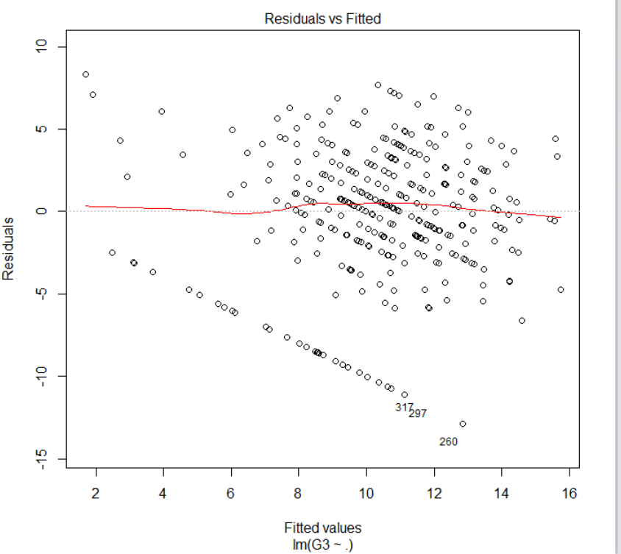
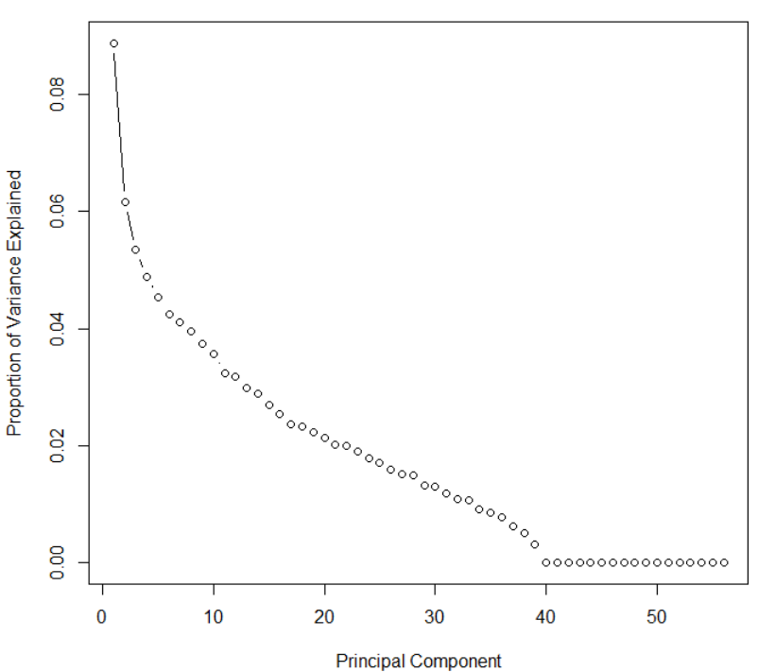
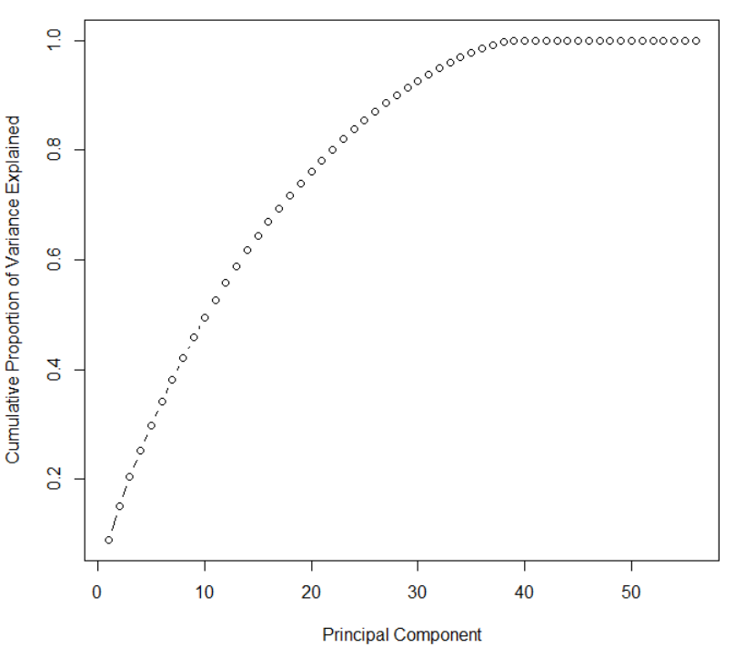
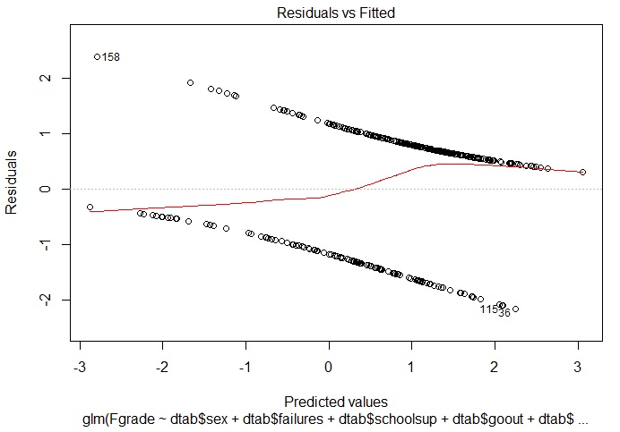
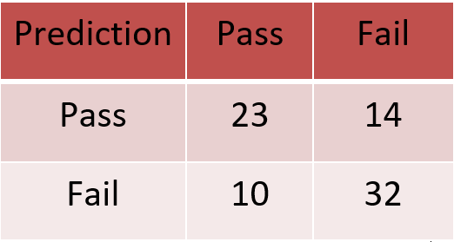
Student Grade Prediction Gaurav Sawant, Vipul Gajbhiye, Vikram Singh
Statistical Learning & Analytics
Fall 2017
Introduction: Problem
Analyzing students’ demographic information, habits & alcohol consumption patterns to understand their impact on grades
Identifying the significant variables and predicting student grades
Data Understanding
Observations for 396 students based on 33 attributes
Target variables: First Period, Second Period & Final Grades
Data Preparation
Categorical variables are transformed into factor variables
We have split the data into a training set and a test set and we have used 80:20 split
Multiple Regression
We have come down to 8 significant variables from a total of 30 independent variables
Naïve Bayes
K Nearest Neighbor
K = 5
 | Estimate | Std. Error | T-value | Pr(>|t|)
intercept | 16.59743 | 4.58358 | 3.621 | 0.000349
sex | -1.22655 | 0.56493 | -2.171 | 0.030765
address | -0.78451 | 0.66353 | -1.182 | 0.238085
failures | -1.68769 | 0.38958 | -4.332 | 2.07e-05*
schoolsup | 1.64477 | 0.74195 | 2.217 | 0.02745*
freetime | 0.47227 | 0.26573 | 1.777 | 0.076619
goout | -0.58106 | 0.25336 | -2.293 | 0.022570
health | -0.37157 | 0.18309 | -2.029 | 0.043368
absences | 0.06339 | 0.03317 | 1.911 | 0.057010
Accuracy = 67.08%
Accuracy = 68.35%
Principal Component Analysis
We have 57 variables after addition of dummy variables
15 PCs explain 64.44% of variance
Logistic Regression
Done on the significant variables
Accuracy = 69.62%
Logistic Regression using 15 PCs
Accuracy = 69.62%
Conclusion
After testing the data on various classification algorithms, we can conclude that almost all the tested algorithms return similar accuracy
We can also conclude that alcohol consumption variables earlier considered important in influencing grades don’t play any significant role

